Slide 1
Natural isotope abundance correction
A new tool available to you via github:
https://github.com/BrynMarieR/natural_isotope_correction
Literature sources: Midani et al, 2016
Yang et al, 2009
Buescher et al, 2015

Slide 2
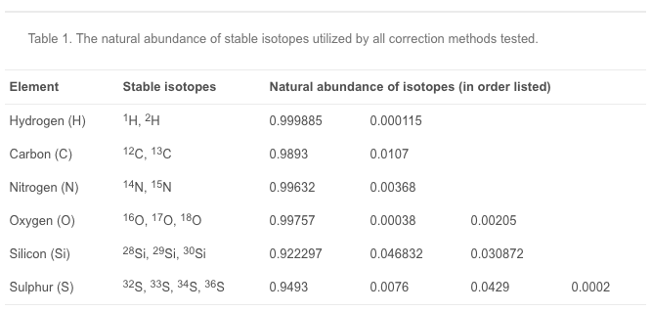
Why do we need isotopic natural abundance (NA) correction?
Important to separate isotopic labelling that came from the addition of an isotopically labelled tracer and isotopic labelling that came from the natural abundance of stable isotopes.

Slide 3
Use cases for NA correction
Quantitative measures of labelling substrate
Mass isotopomer distribution analysis
Metabolic flux analysis

Slide 4
When do you not need NA correction?
Qualitative assessments of functional enrichment assays
Especially in the case of small molecules (expected natural abundance is low)
Singly-labelled metabolites (simple subtraction-based method for correction is equivalent when just looking at the M+1 peak)

Slide 5
Motivating example: Pyruvate
C₃H₃O₃
Two in silico experiments: We want to know, what is the mass isotopomer distribution of the purposefully labelled portion?

Slide 6
Two methods: “classical” and “skewed”
Classical method assumes that for any metabolite, the mass isotope distribution of an labeled standard (with known enrichment of isotopes) is equivalent to an unlabeled standard (without any enriched isotopes).
It is empirically known that this assumption is WRONG. Therefore, the “skewed” method was developed to take into account the change in isotope distributions due to experimental isotopic enrichment.

Slide 7
A very simple implementation of the ”skewed” method for NA correction
Create input file of uncorrected, labelled peak intensities (normalized to parent peak = 1)
Run script
Output is a file with abundance of labelled species (normalized to parent peak = 1)

Slide 8
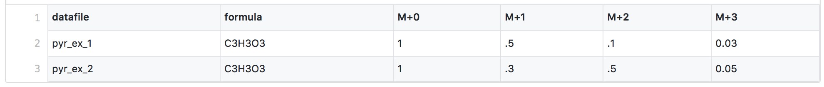
Input file

Slide 9
What’s happening inside the script?
MID = Mass isotopomer distribution
So, the observed MID is equal to the Correction Matrix (CM) of the molecule (in this case, pyruvate) times the corrected MID.
Then just solve for the corrected MID! Using non-negative least-squares solver to ensure that we get no negative peak values, as recommended by the literature and as present in IsoCor, which used to be used for isotope NA correction before the demise of pythonxy.

Slide 10
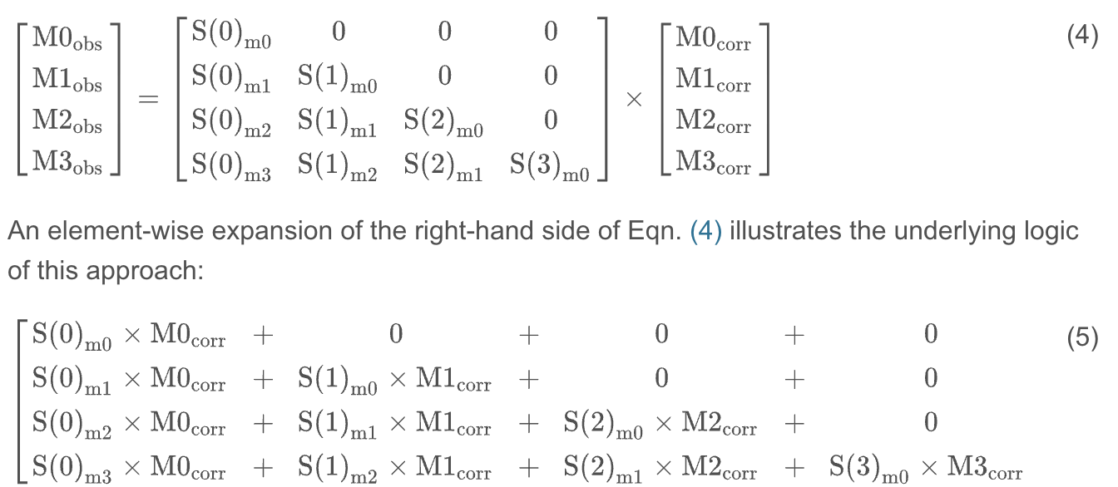
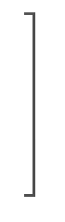
Matrix Multiplication Step

Slide 11
What’s happening inside the script?
MID = Mass isotopomer distribution
So, the observed MID is equal to the Correction Matrix (CM) of the molecule (in this case, pyruvate) times the corrected MID.
Then just solve for the corrected MID! Using non-negative least-squares solver to ensure that we get no negative peak values, as recommended by the literature and as present in IsoCor, which used to be used for isotope NA correction before the demise of pythonxy.

Slide 12
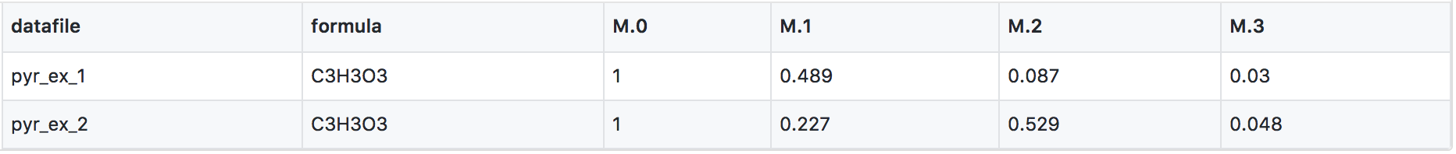
Output file

Slide 13
How much of a difference does it make to correct for NA of isotopologues?

Slide 14
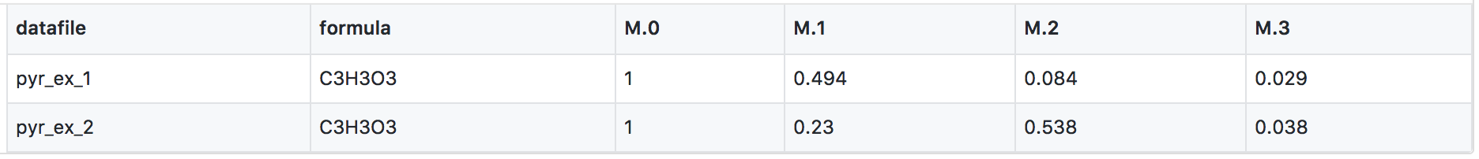
Numerical comparison of outputs
Input
Classical method
Skewed method

Slide 15
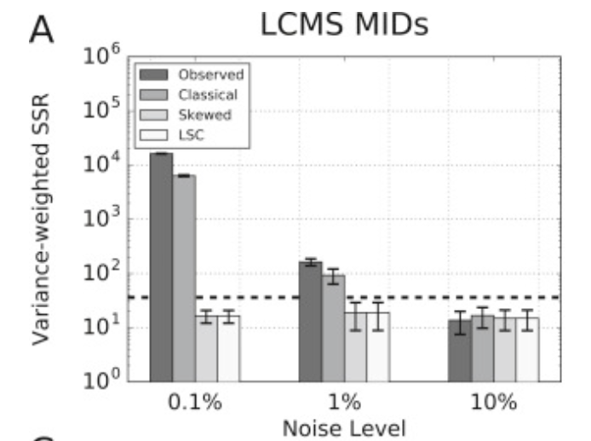
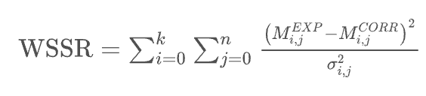
How well does the skewed method work vs the classical method vs no correction?
In high-noise conditions, the error due to natural abundance (as compared to the noise error) is very small, and since the variance-weighted sum-of-squares-residual attempts to “correct” for the amount of error due to noise (variance), we see that all methods reach the goodness-of-fit cutoff.

Slide 16
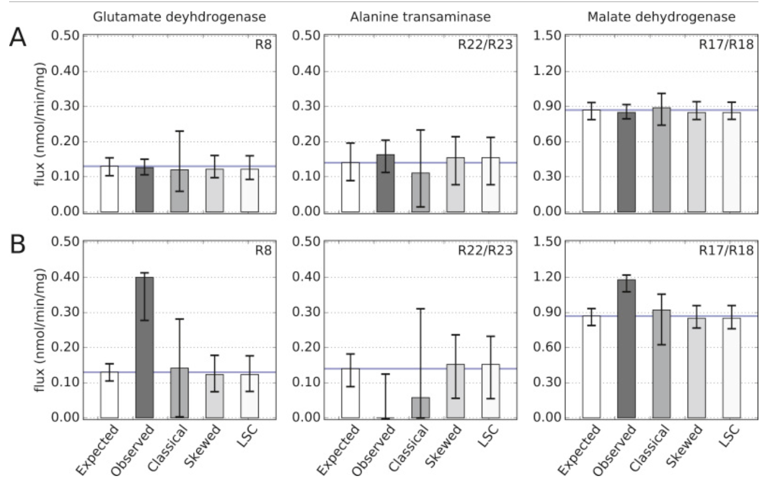
How much of a difference does this correction make in flux analysis?

Slide 17
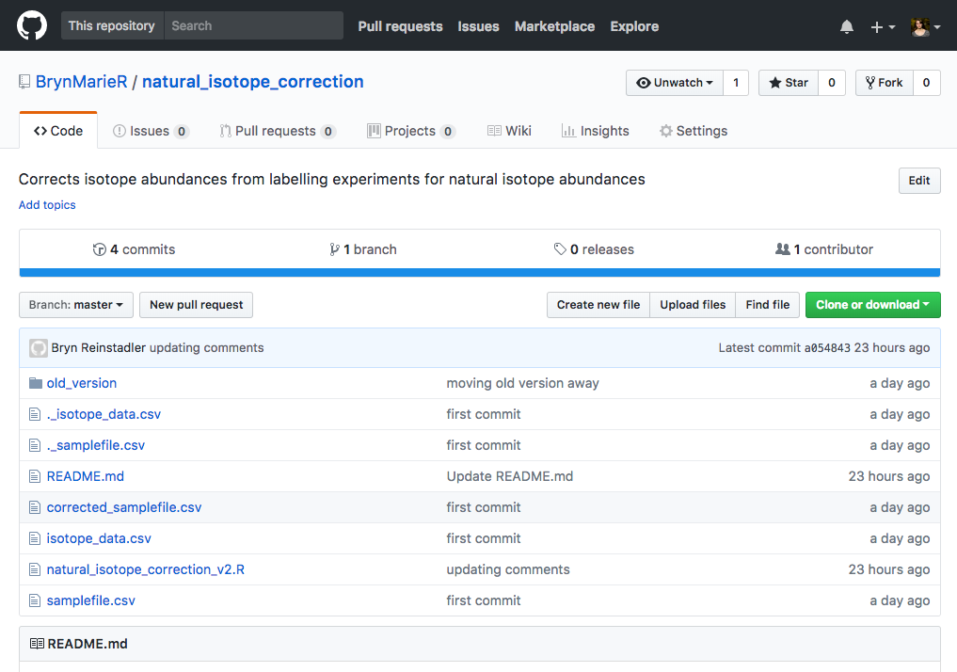
All details for running available on github
https://github.com/BrynMarieR/natural_isotope_correction

Slide 18
Some notes
You will need to install R and a few R packages
Any elements in your compound which are not in the isotope_data file will need to be added to that file
The ideal would be to use unlabeled peaks to build correction matrices. Currently, correction matrices are generated analytically based on expected isotopomer distributions
Purity of the labelling reagent can be taken into account using a flag, e.g. `--purity 0.95`

Slide 19
Conclusions
If you’re ONLY examining the M+1 peak, the classical and skewed approaches are the same if you only examine peak intensities (rather than normalizing to the parent peak)
If you are looking at M+2, M+3, M+4… peaks and doing NA correction, you should used the skewed method
Larger molecules lead to more heavy isotopologues “by chance”
More labels, more isotope distribution skew! Adding 5 labelled carbons will skew your experiment more than adding 2.
The actual percent change of peak intensities is fairly small, but can be critical in quantitative studies, e.g. metabolite flux analysis.

